Slide 1

Natural Language Processing
Yue Zhang
Westlake University

Slide 2
Chapter 5
Using Information Theory

Slide 3
Contents
5.1 The maximum entropy principle
5.1.1 Information and entropy
5.1.2 A naïve maximum entropy model
5.1.3 Maximum entropy model and training data
5.2 KL-Divergence, Cross-Entropy and Model Perplexity
5.2.1 KL-divergence
5.2.2 Cross entropy
5.2.3 Model Perplexity
5.3 Mutual information
5.3.1 Pointwise mutual information
5.3.2 Using PMI

Slide 4
Contents
5.1 The maximum entropy principle
5.1.1 Information and entropy
5.1.2 A naïve maximum entropy model
5.1.3 Maximum entropy model and training data
5.2 KL-Divergence, Cross-Entropy and Model Perplexity
5.2.1 KL-divergence
5.2.2 Cross entropy
5.2.3 Model Perplexity
5.3 Mutual information
5.3.1 Pointwise mutual information
5.3.2 Using PMI

Slide 5
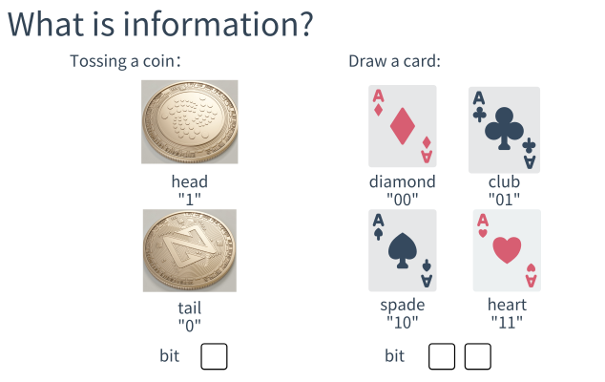
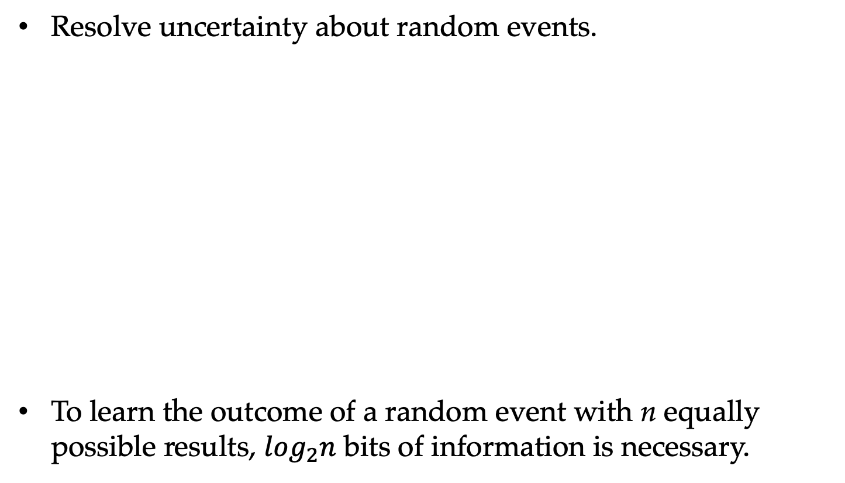
What is information?
Resolve uncertainty about random events.
To learn the outcome of a random event with n equally possible results, $log_{2}n$ bits of information is necessary.

Slide 6
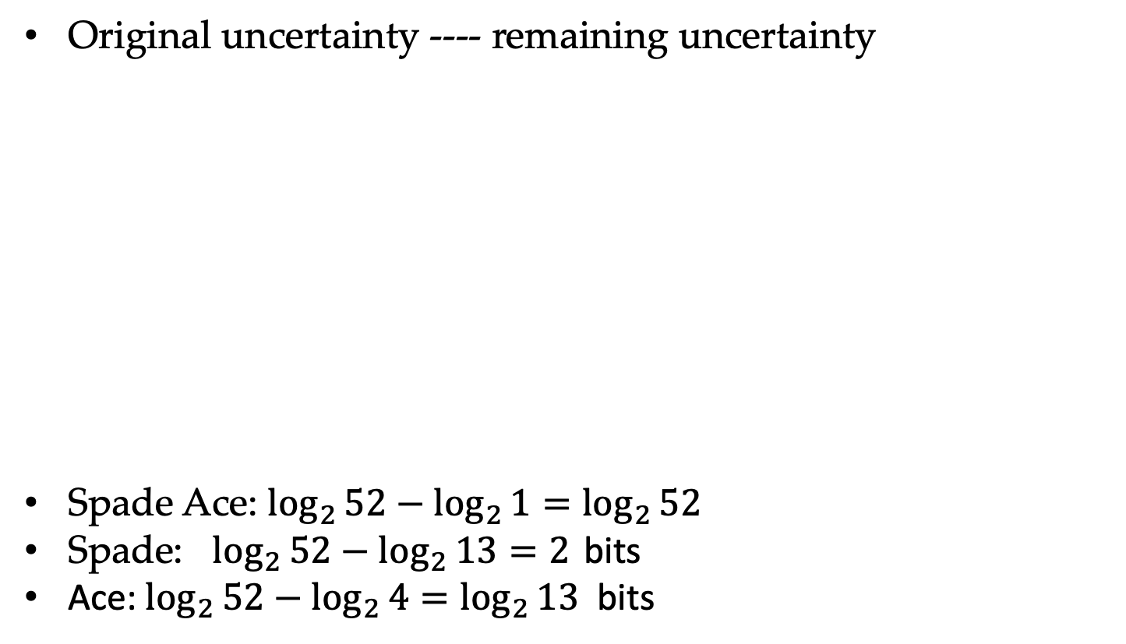
Information of event.
Original uncertainty ---- remaining uncertainty
Spade Ace: $\log_{2}{52−\log_{2}{1=\log_{2}{52}}}$
Spade: $\log_{2}{52}−\log_{2}{13}=2$ bits
Ace: $\log_{2}{52}−\log_{2}{4}=\log_{2}{13}$ bits

Slide 7
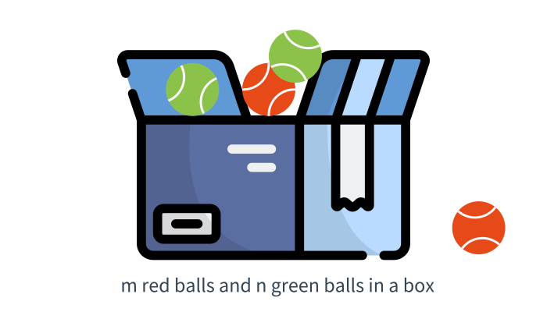
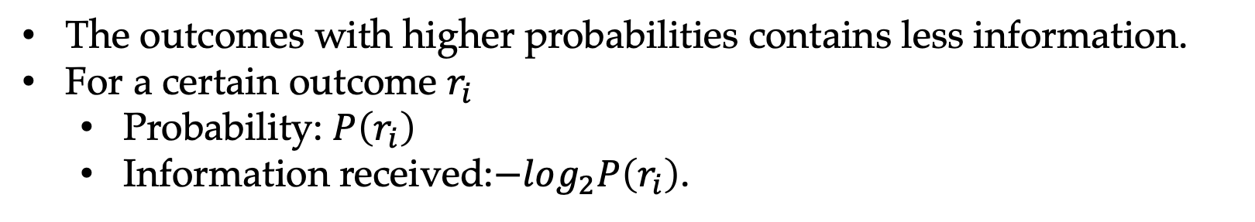
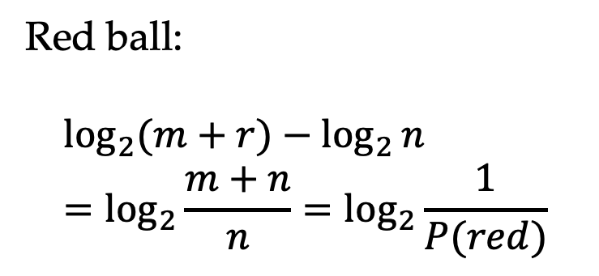
Information for non-uniform distributions
Red ball:
$$\log_{2}{(m+r)}−\log_{2}{n}=\log_{2}{\frac{m+n}{n}}=\log_{2}{\frac{1}{P(red)}}$$
The outcomes with higher probabilities contains less information.
For a certain outcome $r_{i}$
Probability: $P\left(r_{i}\right)$
Information received:$−log_{2}P\left(r_{i}\right)$.

Slide 8

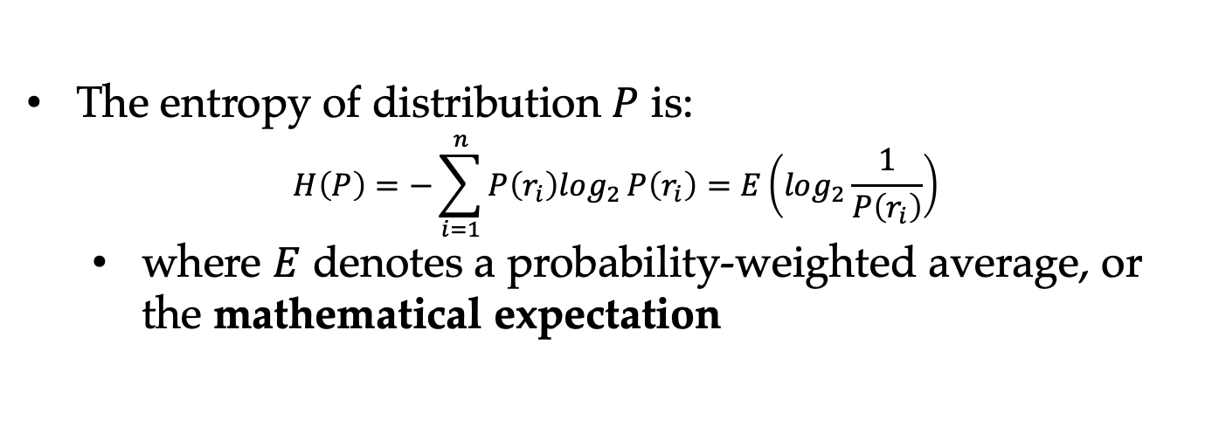
Entropy
Entropy analyzes information concerning events by considering all possible outcomes or random variables by considering all possible values.
The entropy of distribution $P$ is:
$$H\left(P\right)=−\sum_{i=1}^{n}{P\left(r_{i}\right)log_{2}}P\left(r_{i}\right)=E\left(log_{2}\frac{1}{P\left(r_{i}\right)}\right)$$
where $E$ denotes a probability-weighted average, or the mathematical expectation

Slide 9
Entropy and distribution characteristics
Encoding six numbers
Uniform distribution
3 bits 001 010 011 100 101 110
90% case with number 1, and 2% with 2, 3, 4, 5, 6
0 1010 1011 1110 1101 1110
0.9 x 1+ 0.1 x 4 =1.3 bits

Slide 10
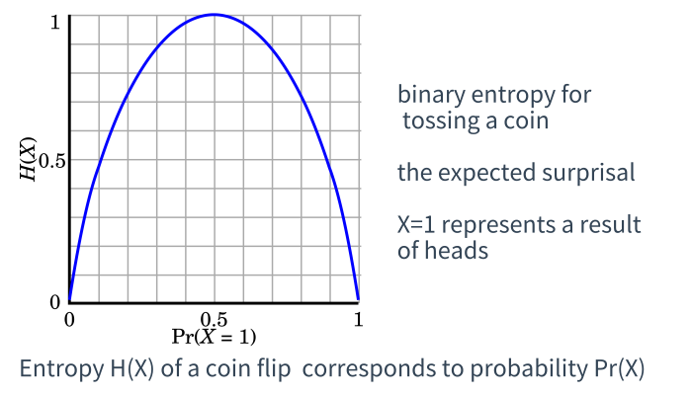
Entropy
Events with uniform output distributions have the largest entropy.
The more uneven the distribution is, the smaller the entropy is.

Slide 11
Contents
5.1 The maximum entropy principle
5.1.1 Information and entropy
5.1.2 A naïve maximum entropy model
5.1.3 Maximum entropy model and training data
5.2 KL-Divergence, Cross-Entropy and Model Perplexity
5.2.1 KL-divergence
5.2.2 Cross entropy
5.2.3 Model Perplexity
5.3 Mutual information
5.3.1 Pointwise mutual information
5.3.2 Using PMI

Slide 12

Occam’s razor
A principle attributed to the fourteenth-century English Franciscan friar William of Ockham, which states that “entities should not be multiplied beyond necessity”
Occam’s razor shares underlying similarities with the maximum entropy principle.

Slide 13
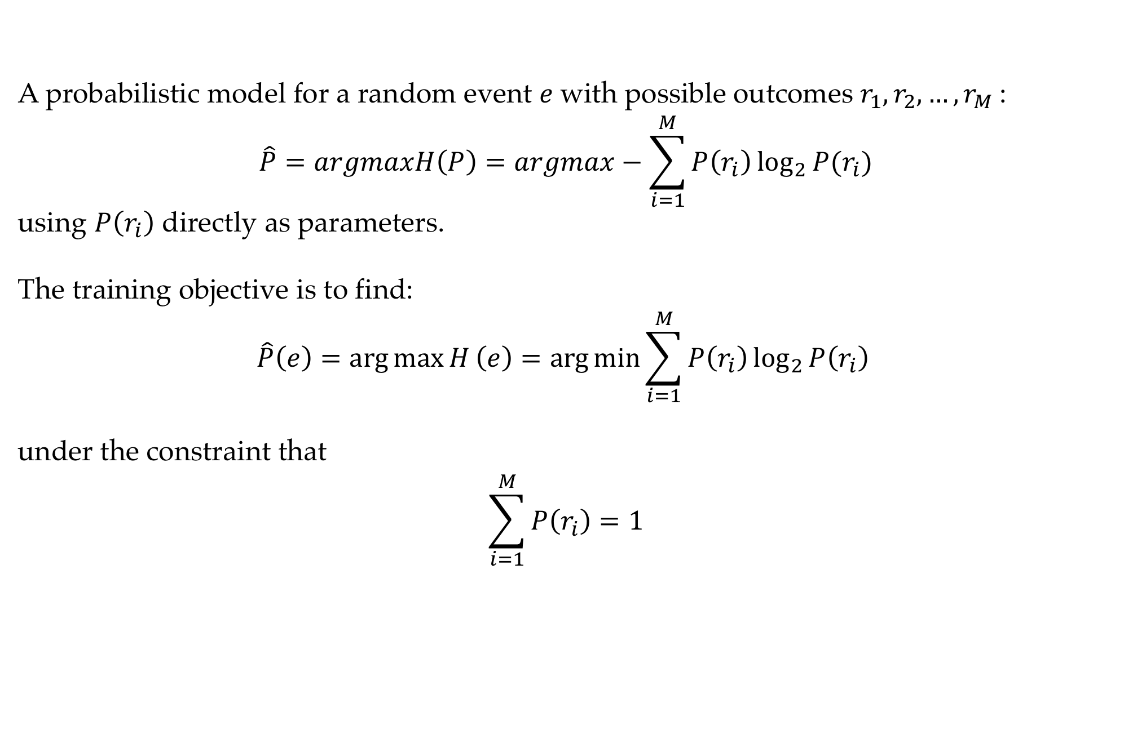
A naive maximum entropy model
A probabilistic model for a random event $e$with possible outcomes $r_{1},r_{2},…,r_{M}$:
$$\hat{P}=argmaxH\left(P\right)=argmax−\sum_{i=1}^{M}{P\left(r_{i}\right)\log_{2}{P(r_{i})}}$$
using $P\left(r_{i}\right)$ directly as parameters.
The training objective is to find:
$$\hat{P}\left(e\right)=\arg{\max{H}}\left(e\right)=\arg{\min{\sum_{i=1}^{M}{P\left(r_{i}\right)\log_{2}{P\left(r_{i}\right)}}}}$$
under the constraint that
$$\sum_{i=1}^{M}{P\left(r_{i}\right)}=1$$

Slide 14
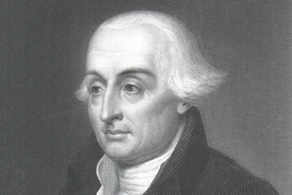
A naive maximum entropy model
Taking each $P\left(r_{i}\right)$ as a separate variable, we use Lagrange multipliers to do the optimization.
In mathematic optimization, the method of Lagrange multipliers is a strategy for finding the local maxima and minima of a function subject to equality constraints.

Slide 15
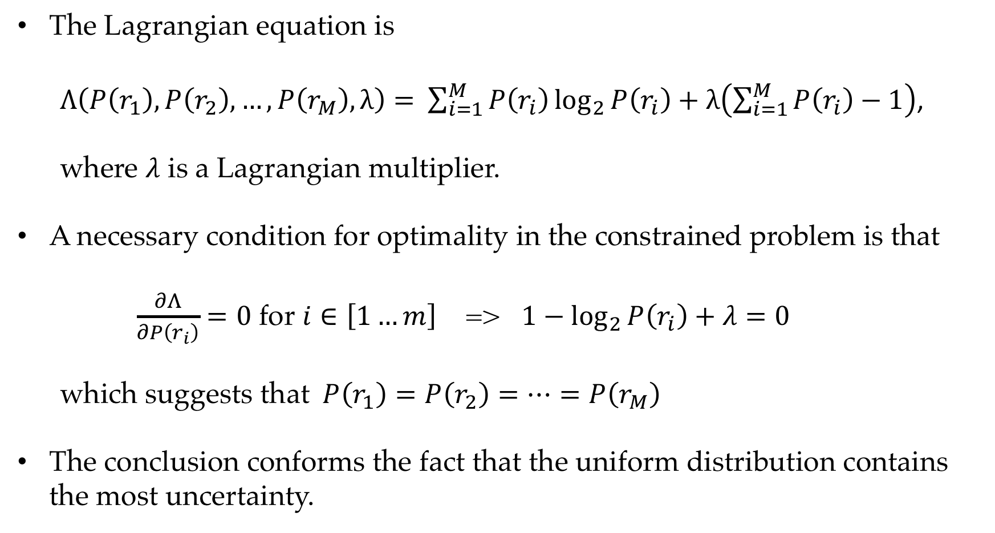
A naive maximum entropy model
The Lagrangian equation is
$Λ\left(P\left(r_{1}\right),P\left(r_{2}\right),…,P\left(r_{M}\right),λ\right)=$ $\sum_{i=1}^{M}{P\left(r_{i}\right)\log_{2}{P\left(r_{i}\right)}}+λ\left(\sum_{i=1}^{M}{P\left(r_{i}\right)}−1\right)$,
where $λ$ is a Lagrangian multiplier.
A necessary condition for optimality in the constrained problem is that
$\frac{∂Λ}{∂P\left(r_{i}\right)}=0$ for $i∈\left[1…m\right]$ => $1−\log_{2}{P\left(r_{i}\right)}+λ=0$
which suggests that $P\left(r_{1}\right)=P\left(r_{2}\right)=⋯=P\left(r_{M}\right)$
The conclusion conforms the fact that the uniform distribution contains the most uncertainty.

Slide 16
Contents
5.1 The maximum entropy principle
5.1.1 Information and entropy
5.1.2 A naïve maximum entropy model
5.1.3 Maximum entropy model and training data
5.2 KL-Divergence, Cross-Entropy and Model Perplexity
5.2.1 KL-divergence
5.2.2 Cross entropy
5.2.3 Model Perplexity
5.3 Mutual information
5.3.1 Pointwise mutual information
5.3.2 Using PMI

Slide 17
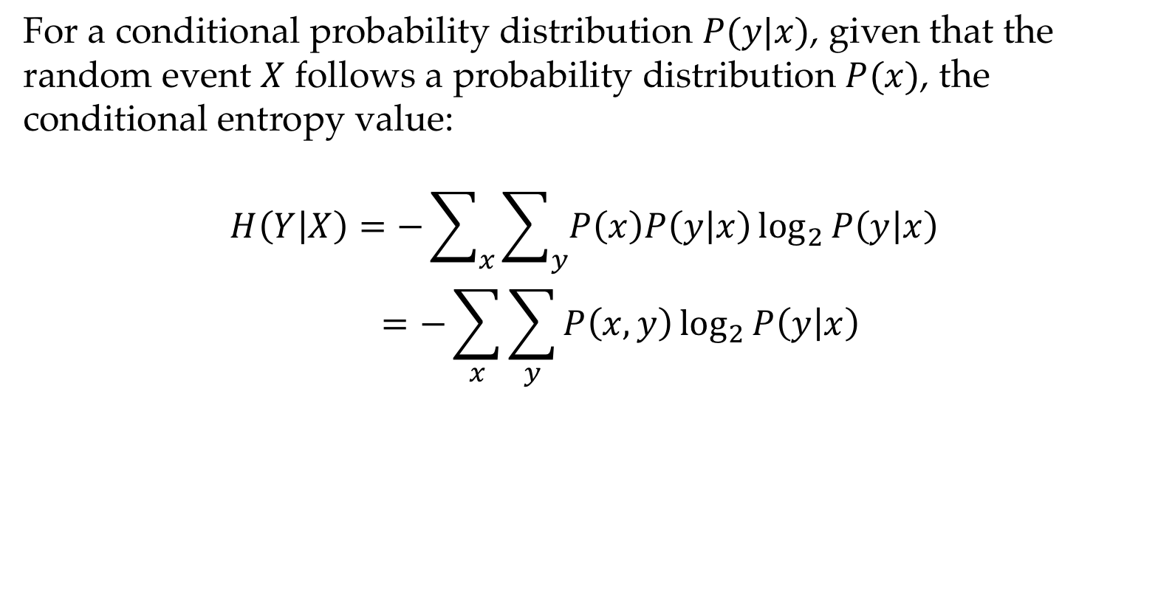
Conditional entropy
For a conditional probability distribution $P(y|x)$, given that the random event $X$ follows a probability distribution $P(x)$, the conditional entropy value:
$$H\left(Y | X\right)=−\sum_{x}{\sum_{y}{P\left(x\right)P\left(y | x\right)\log_{2}{P\left(y | x\right)}}}$$
$$=−\sum_{x}{\sum_{y}{P\left(x,y\right)\log_{2}{P\left(y | x\right)}}}$$

Slide 18
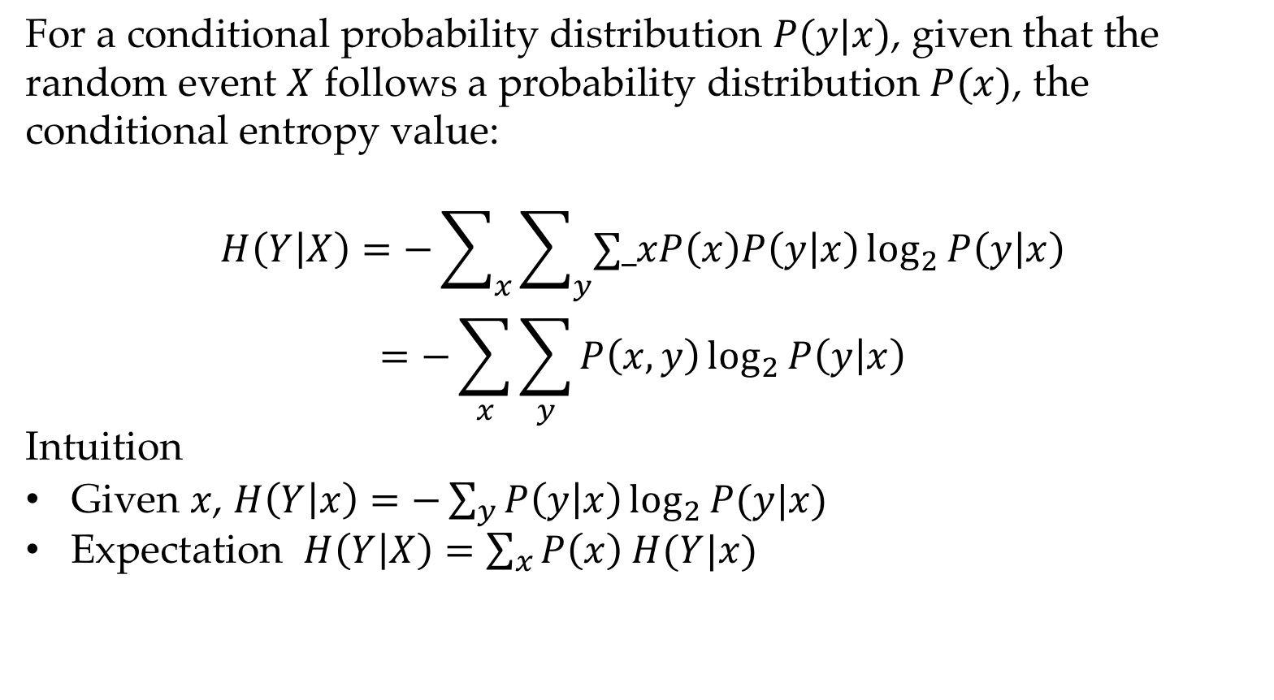
Conditional entropy
For a conditional probability distribution $P(y|x)$, given that the random event $X$ follows a probability distribution $P(x)$, the conditional entropy value:
$$H\left(Y | X\right)=−\sum_{x}{\sum_{y}{∑_xP\left(x\right)P\left(y | x\right)\log_{2}{P\left(y | x\right)}}}$$
$$=−\sum_{x}{\sum_{y}{P\left(x,y\right)\log_{2}{P\left(y | x\right)}}}$$
Intuition
Given $x$, $H\left(Y | x\right)=−\sum_{y}{P\left(y | x\right)\log_{2}{P(y|x)}}$
Expectation $H\left(Y | X\right)=\sum_{x}{P\left(x\right) H(Y|x)}$

Slide 19
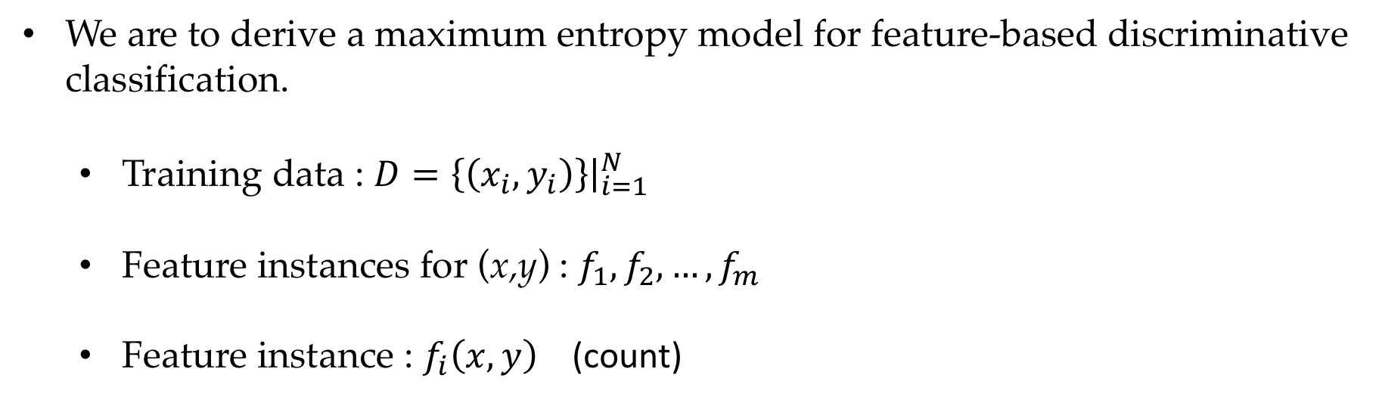
Maximum entropy model and training data
We are to derive a maximum entropy model for feature-based discriminative classification.
Training data : $D={\left.\left\{\left(x_{i},y_{i}\right)\right\}\right|}_{i=1}^{N}$
Feature instances for (x,y) : $f_{1},f_{2},…,f_{m}$
Feature instance : $f_{i}\left(x,y\right)$ (count)

Slide 20
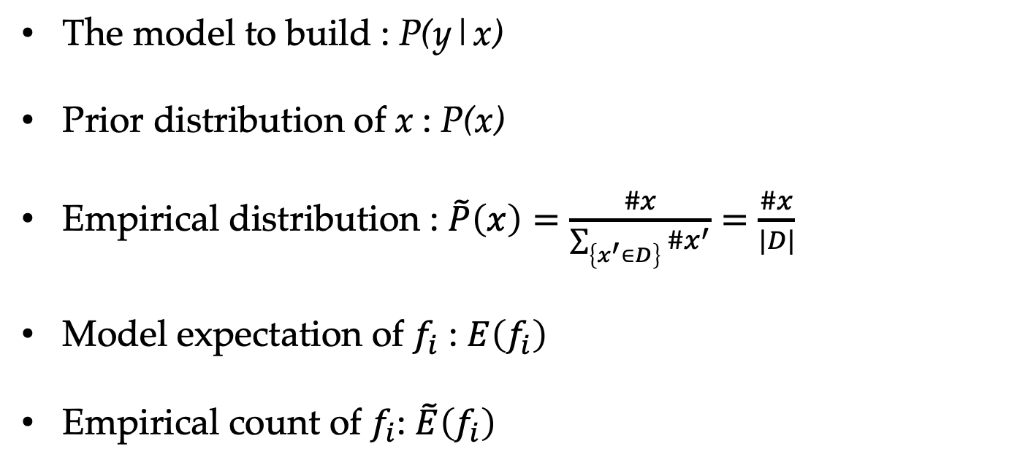
Notations
The model to build : P(y|x)
Prior distribution of x : P(x)
Empirical distribution : $\tilde{P}\left(x\right)=\frac{\#x}{\sum_{\left\{x^{′}∈D\right\}}{\#x^{′}}}=\frac{\#x}{|D|}$
Model expectation of $f_{i}$ : $E\left(f_{i}\right)$
Empirical count of $f_{i}$: $\tilde{E}\left(f_{i}\right)$

Slide 21
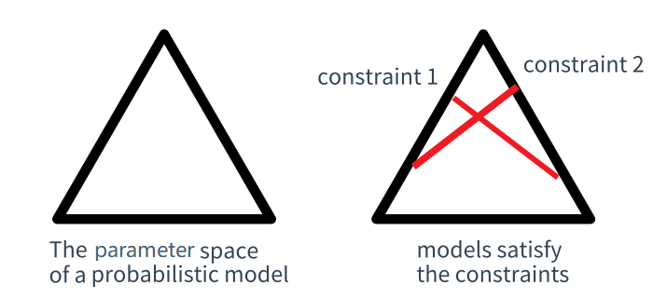
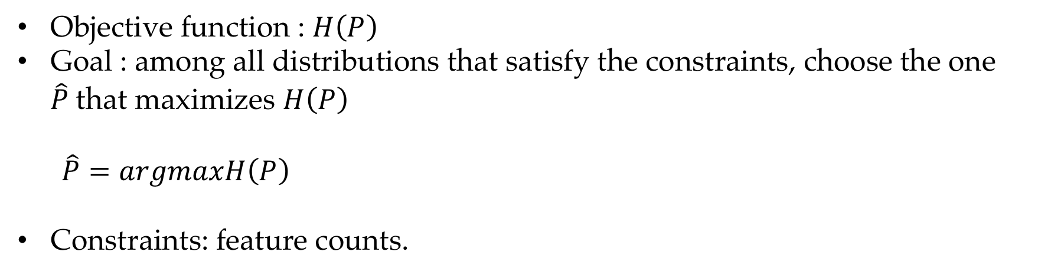
Modelling the problem
Objective function : $H\left(P\right)$
Goal : among all distributions that satisfy the constraints, choose the one $\hat{P}$that maximizes $H\left(P\right)$
$\hat{P}=argmaxH\left(P\right)$
Constraints: feature counts.

Slide 22
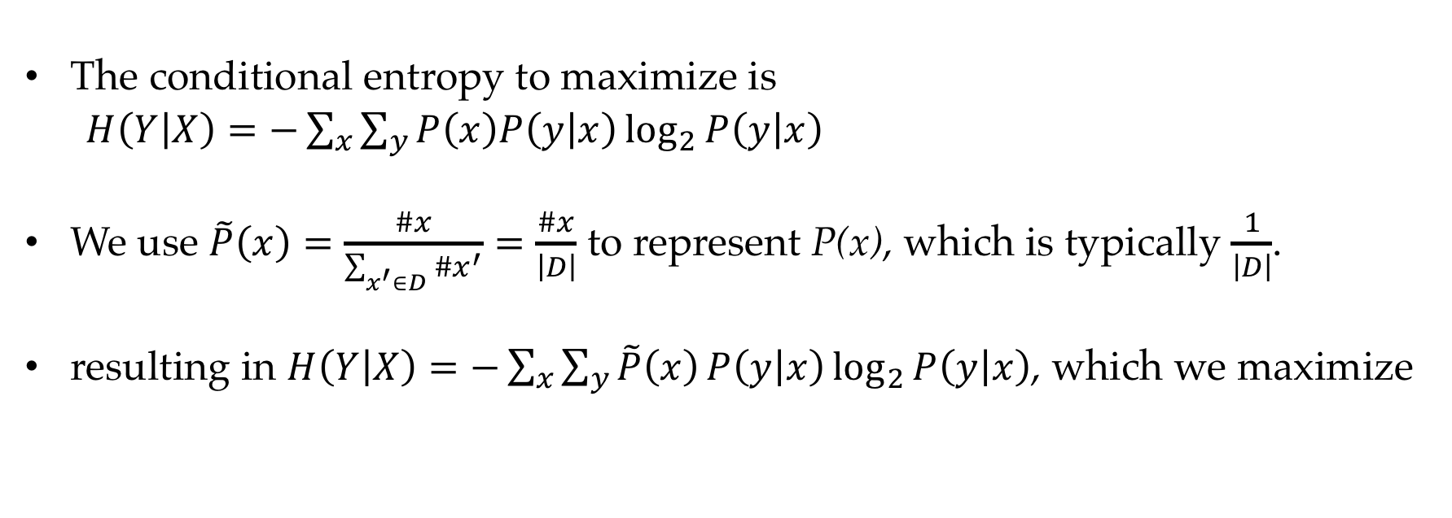
Objective
The conditional entropy to maximize is
$H\left(Y | X\right)=−\sum_{x}{\sum_{y}{P\left(x\right)P\left(y | x\right)\log_{2}{P\left(y | x\right)}}}$
We use $\tilde{P}\left(x\right)=\frac{\#x}{\sum_{x^{′}∈D}{\#x^{′}}}=\frac{\#x}{\left|D\right|}$ to represent P(x), which is typically $\frac{1}{\left|D\right|}$.
resulting in $H\left(Y | X\right)=−\sum_{x}{\sum_{y}{\tilde{P}\left(x\right)}P\left(y | x\right)\log_{2}{P\left(y | x\right)}}$, which we maximize

Slide 23
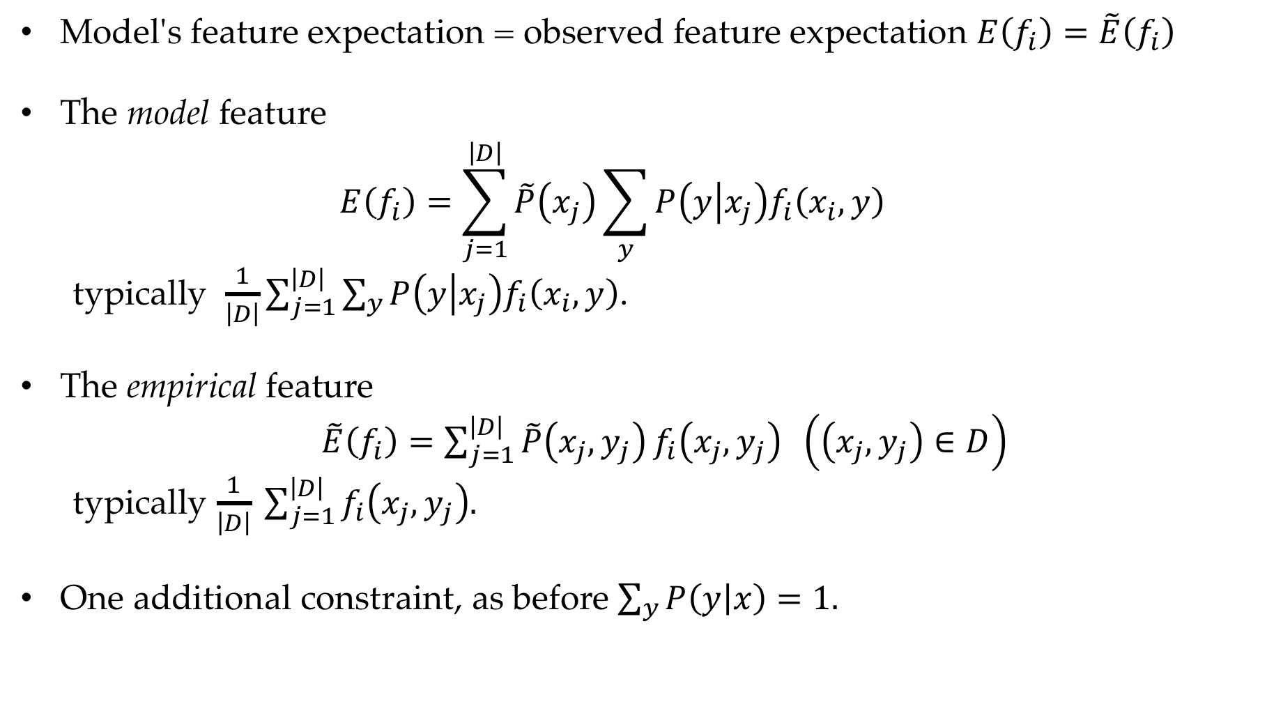
Constraints
Model's feature expectation = observed feature expectation $E\left(f_{i}\right)=\tilde{E}\left(f_{i}\right)$
The model feature
$$E\left(f_{i}\right)=\sum_{j=1}^{\left|D\right|}{\tilde{P}\left(x_{j}\right)\sum_{y}{P\left(y | x_{j}\right)f_{i}\left(x_{i},y\right)}}$$
typically $\frac{1}{\left|D\right|}\sum_{j=1}^{\left|D\right|}{\sum_{y}{P\left(y | x_{j}\right)f_{i}\left(x_{i},y\right)}}$.
The empirical feature
$\tilde{E}\left(f_{i}\right)=\sum_{j=1}^{\left|D\right|}{\tilde{P}\left(x_{j},y_{j}\right)}f_{i}\left(x_{j},y_{j}\right) \left(\left(x_{j},y_{j}\right)∈D\right)$
typically $\frac{1}{\left|D\right|} \sum_{j=1}^{\left|D\right|}{f_{i}\left(x_{j},y_{j}\right).}$
One additional constraint, as before $\sum_{y}{P\left(y | x\right)}=1.$

Slide 24
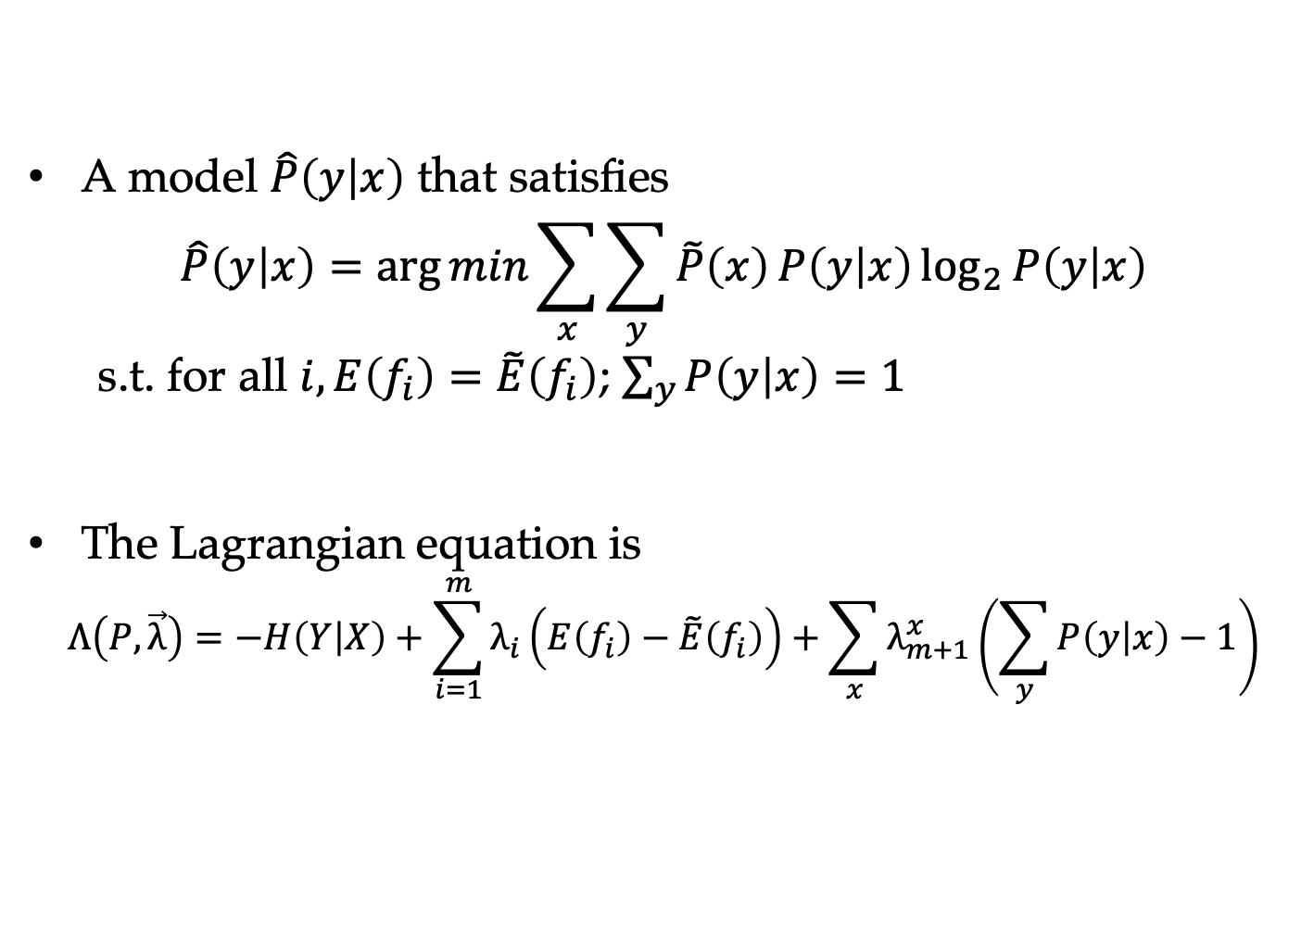
Using Lagrangian multipliers
A model $\hat{P}\left(y | x\right)$ that satisfies
$$\hat{P}\left(y | x\right)=\arg{min}\sum_{x}{\sum_{y}{\tilde{P}\left(x\right)}P\left(y | x\right)\log_{2}{P\left(y | x\right)}}$$
s.t. for all $i,E\left(f_{i}\right)=\tilde{E}\left(f_{i}\right)$; $\sum_{y}{P\left(y | x\right)}=1$
The Lagrangian equation is
$$Λ\left(P,\vec{λ}\right)=−H\left(Y | X\right)+\sum_{i=1}^{m}{λ_{i}\left(E\left(f_{i}\right)−\tilde{E}\left(f_{i}\right)\right)}+\sum_{x}{λ_{m+1}^{x}\left(\sum_{y}{P\left(y | x\right)}−1\right)}$$

Slide 25
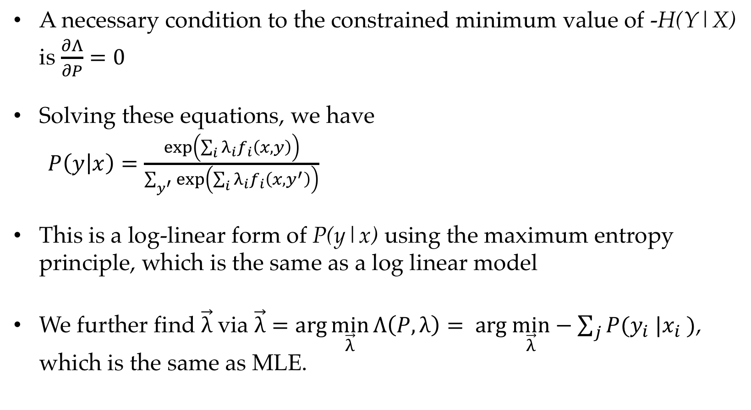
Maximum entropy leads to log-linear models
A necessary condition to the constrained minimum value of -H(Y|X) is $\frac{∂Λ}{∂P}=0$
Solving these equations, we have
$P\left(y | x\right)=\frac{\exp\left(\sum_{i}{λ_{i}}f_{i}\left(x,y\right)\right)}{\sum_{y^{′}}{\exp\left(\sum_{i}{λ_{i}}f_{i}\left(x,y^{′}\right)\right)}}$
This is a log-linear form of P(y|x) using the maximum entropy principle, which is the same as a log linear model
We further find $\vec{λ}$ via $\vec{λ}=\arg{\min_{\vec{λ}}{Λ\left(P,λ\right)}}= arg \min_{\vec{λ}}−\sum_{j}{P(y_{i} |x_{i} )}$, which is the same as MLE.

Slide 26
Contents
5.1 The maximum entropy principle
5.1.1 Information and entropy
5.1.2 A naïve maximum entropy model
5.1.3 Maximum entropy model and training data
5.2 KL-Divergence, Cross-Entropy and Model Perplexity
5.2.1 KL-divergence
5.2.2 Cross entropy
5.2.3 Model Perplexity
5.3 Mutual information
5.3.1 Pointwise mutual information
5.3.2 Using PMI

Slide 27
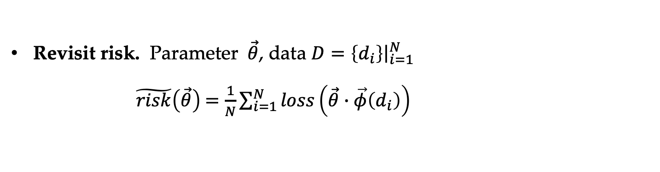
KL-divergence
Revisit risk. Parameter $\vec{θ}$, data $D=\left\{d_{i}\right\}{\left.​\right|}_{i=1}^{N}$
$\tilde{risk}\left(\vec{θ}\right)$ $=\frac{1}{N}\sum_{i=1}^{N}{loss\left(\vec{θ}∙\vec{φ}\left(d_{i}\right)\right)}$

Slide 28
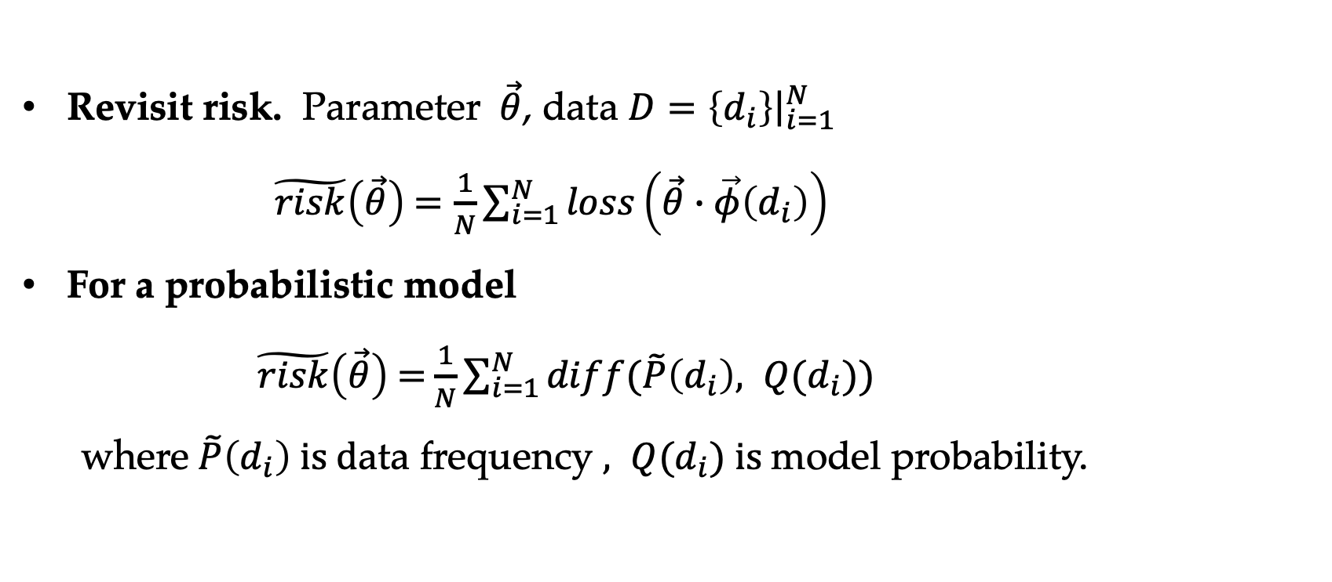
KL-divergence
Revisit risk. Parameter $\vec{θ}$, data $D=\left\{d_{i}\right\}{\left.​\right|}_{i=1}^{N}$
$\tilde{risk}\left(\vec{θ}\right)$ $=\frac{1}{N}\sum_{i=1}^{N}{loss\left(\vec{θ}∙\vec{φ}\left(d_{i}\right)\right)}$
For a probabilistic model
$\tilde{risk}\left(\vec{θ}\right)$ $=$ $\frac{1}{N}\sum_{i=1}^{N}{diff(\tilde{P}\left(d_{i}\right), Q(d_{i}))}$ where $\tilde{P}\left(d_{i}\right) is d$ata frequency $, Q(d_{i}) is$model probability.

Slide 29
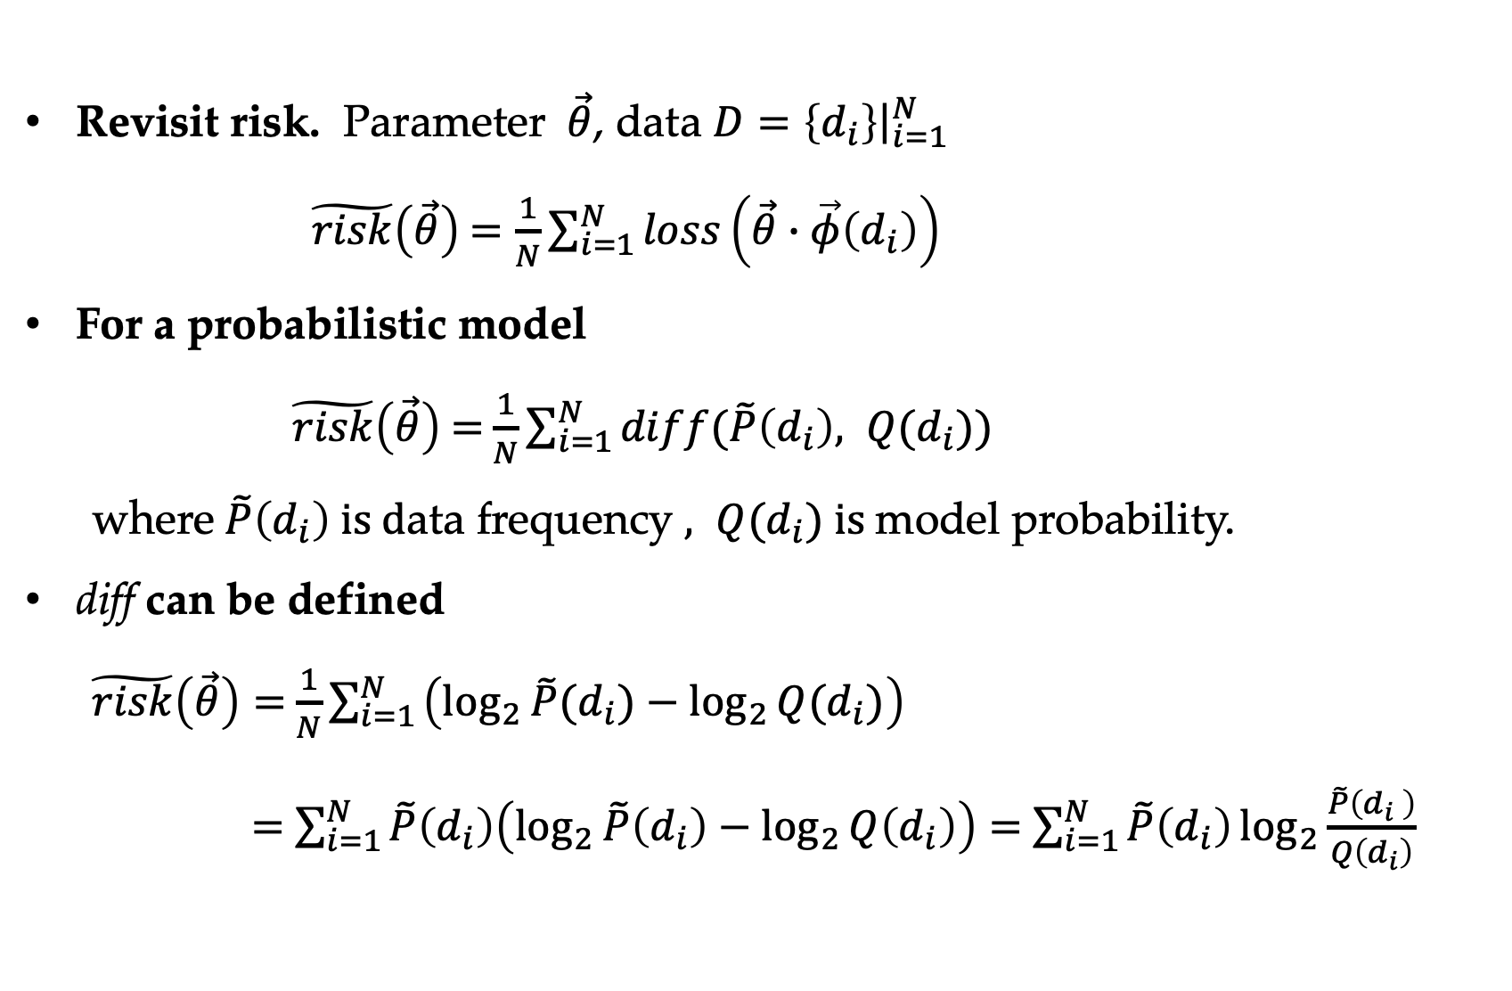
KL-divergence
Revisit risk. Parameter $\vec{θ}$, data $D=\left\{d_{i}\right\}{\left.​\right|}_{i=1}^{N}$
$\tilde{risk}\left(\vec{θ}\right)$ $=\frac{1}{N}\sum_{i=1}^{N}{loss\left(\vec{θ}∙\vec{φ}\left(d_{i}\right)\right)}$
For a probabilistic model
$\tilde{risk}\left(\vec{θ}\right)$ $=$ $\frac{1}{N}\sum_{i=1}^{N}{diff(\tilde{P}\left(d_{i}\right), Q(d_{i}))}$ where $\tilde{P}\left(d_{i}\right) is d$ata frequency $, Q(d_{i}) is$model probability.
diff can be defined
$\tilde{risk}\left(\vec{θ}\right)=$ $\frac{1}{N}\sum_{i=1 }^{N}{\left(\log_{2}{\tilde{P}(d_{i})}−\log_{2}{Q(d_{i})}\right)}$
$=$ $\sum_{i=1}^{N}{\tilde{P}\left(d_{i}\right)\left(\log_{2}{\tilde{P}\left(d_{i}\right)}−\log_{2}{Q\left(d_{i}\right)}\right)}=$ $\sum_{i=1}^{N}{\tilde{P}\left(d_{i}\right)}\log_{2}{\frac{\tilde{P}\left(d_{i} \right)}{Q\left(d_{i}\right)}}$

Slide 30
KL-divergence
Revisit risk. Parameter $\vec{θ}$, data $D=\left\{d_{i}\right\}{\left.​\right|}_{i=1}^{N}$
$\tilde{risk}\left(\vec{θ}\right)$ $=\frac{1}{N}\sum_{i=1}^{N}{loss\left(\vec{θ}∙\vec{φ}\left(d_{i}\right)\right)}$
For a probabilistic model
$\tilde{risk}\left(\vec{θ}\right)$ $=$ $\frac{1}{N}\sum_{i=1}^{N}{diff(\tilde{P}\left(d_{i}\right), Q(d_{i}))}$ where $\tilde{P}\left(d_{i}\right) is d$ata frequency $, Q(d_{i}) is$model probability.
diff can be defined
$\tilde{risk}\left(\vec{θ}\right)=$ $\frac{1}{N}\sum_{i=1 }^{N}{\left(\log_{2}{\tilde{P}(d_{i})}−\log_{2}{Q(d_{i})}\right)}$
$=$ $\sum_{i=1}^{N}{\tilde{P}\left(d_{i}\right)\left(\log_{2}{\tilde{P}\left(d_{i}\right)}−\log_{2}{Q\left(d_{i}\right)}\right)}=$ $\sum_{i=1}^{N}{\tilde{P}\left(d_{i}\right)}\log_{2}{\frac{\tilde{P}\left(d_{i} \right)}{Q\left(d_{i}\right)}}$

Slide 31
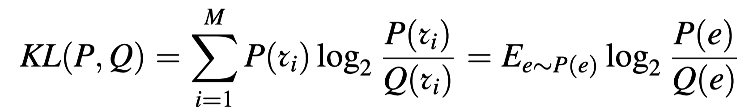
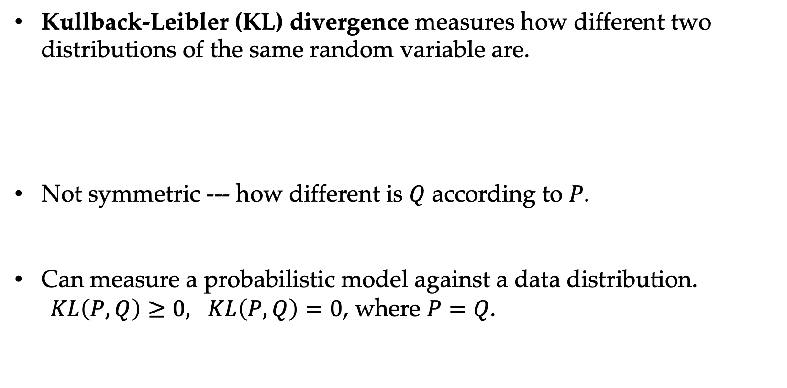
KL-divergence
Kullback-Leibler (KL) divergence measures how different two distributions of the same random variable are.
Not symmetric --- how different is $Q$ according to $P$.
Can measure a probabilistic model against a data distribution.
$KL\left(P, Q\right)≥0, KL\left(P, Q\right)=0$, where $P=Q$.

Slide 32
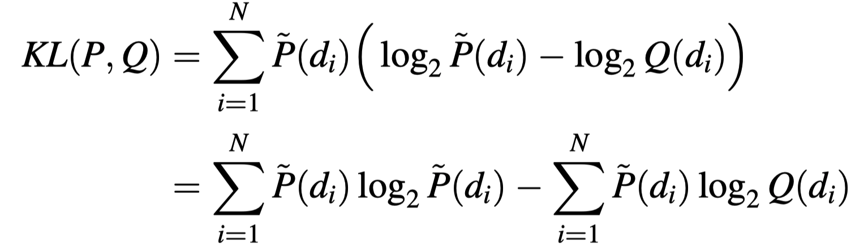
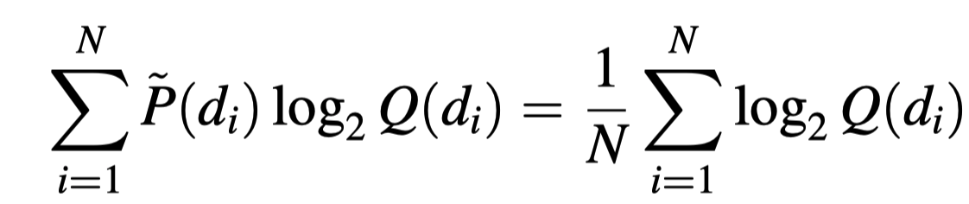
KL-divergence
Loss function:
As the first term is constant, the loss effectively maximizes
which is the exactly log-likelihood of the dataset D, namely MLE.

Slide 33
Contents
5.1 The maximum entropy principle
5.1.1 Information and entropy
5.1.2 A naïve maximum entropy model
5.1.3 Maximum entropy model and training data
5.2 KL-Divergence, Cross-Entropy and Model Perplexity
5.2.1 KL-divergence
5.2.2 Cross entropy
5.2.3 Model Perplexity
5.3 Mutual information
5.3.1 Pointwise mutual information
5.3.2 Using PMI

Slide 34
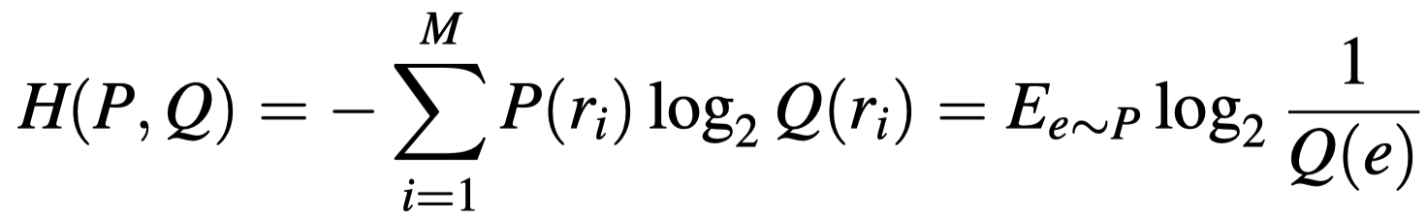
Cross entropy
The second term of KL-divergence is referred to cross-entropy:
It also measures the similarity between two distributions of the same random variable.

Slide 35
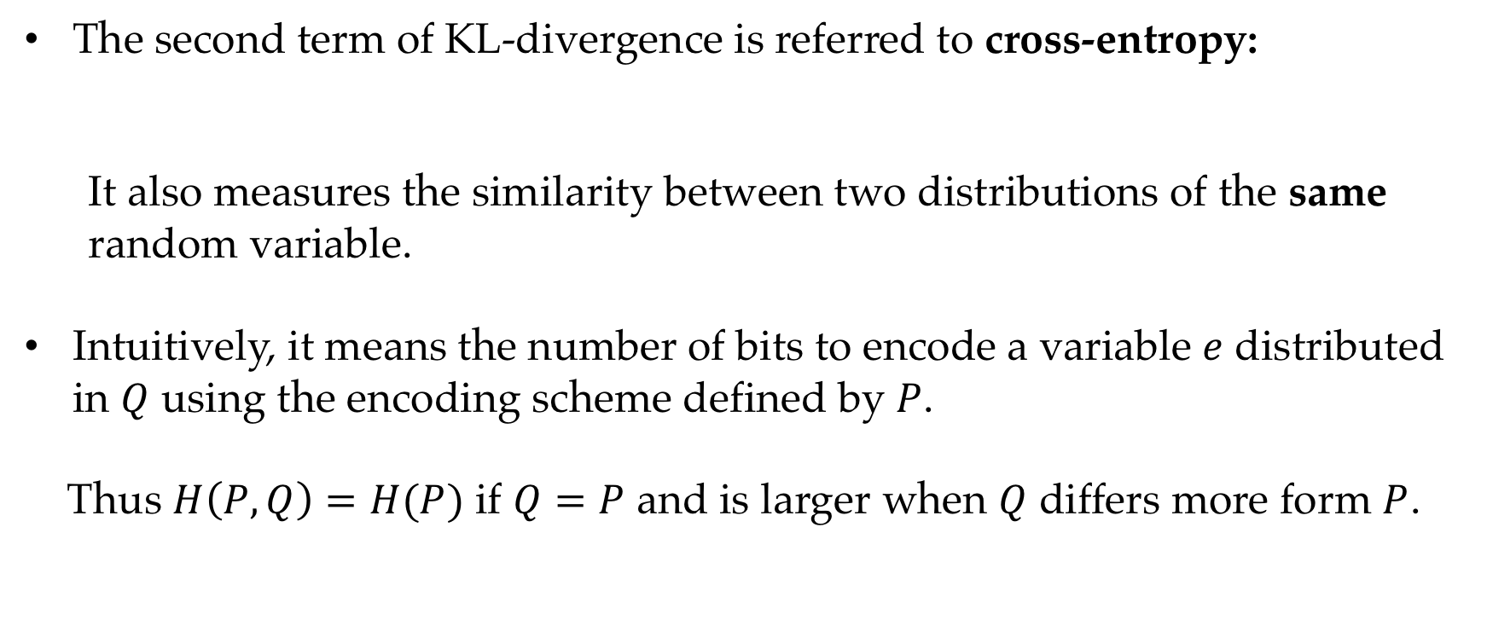
Cross entropy
The second term of KL-divergence is referred to cross-entropy:
It also measures the similarity between two distributions of the same random variable.
Intuitively, it means the number of bits to encode a variable $e$ distributed in $Q$ using the encoding scheme defined by $P$.
Thus $H\left(P, Q\right)=H(P)$ if $Q=P$ and is larger when $Q$ differs more form $P$.

Slide 36
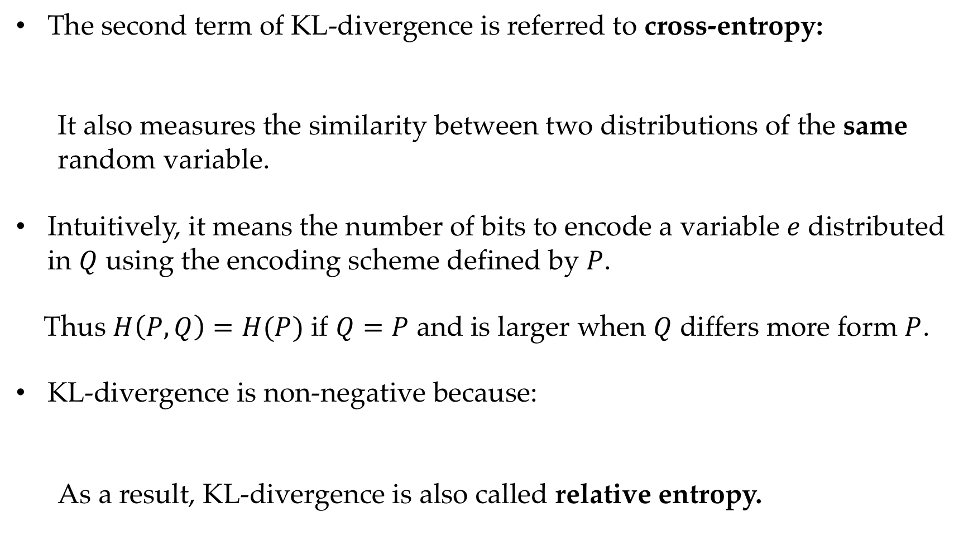
Cross entropy
The second term of KL-divergence is referred to cross-entropy:
It also measures the similarity between two distributions of the same random variable.
Intuitively, it means the number of bits to encode a variable $e$ distributed in $Q$ using the encoding scheme defined by $P$.
Thus $H\left(P, Q\right)=H(P)$ if $Q=P$ and is larger when $Q$ differs more form $P$.
KL-divergence is non-negative because:
As a result, KL-divergence is also called relative entropy.

Slide 37
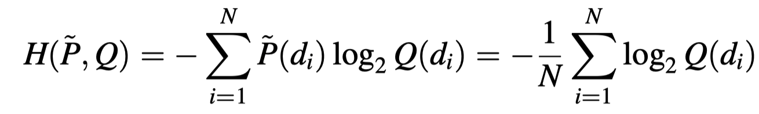
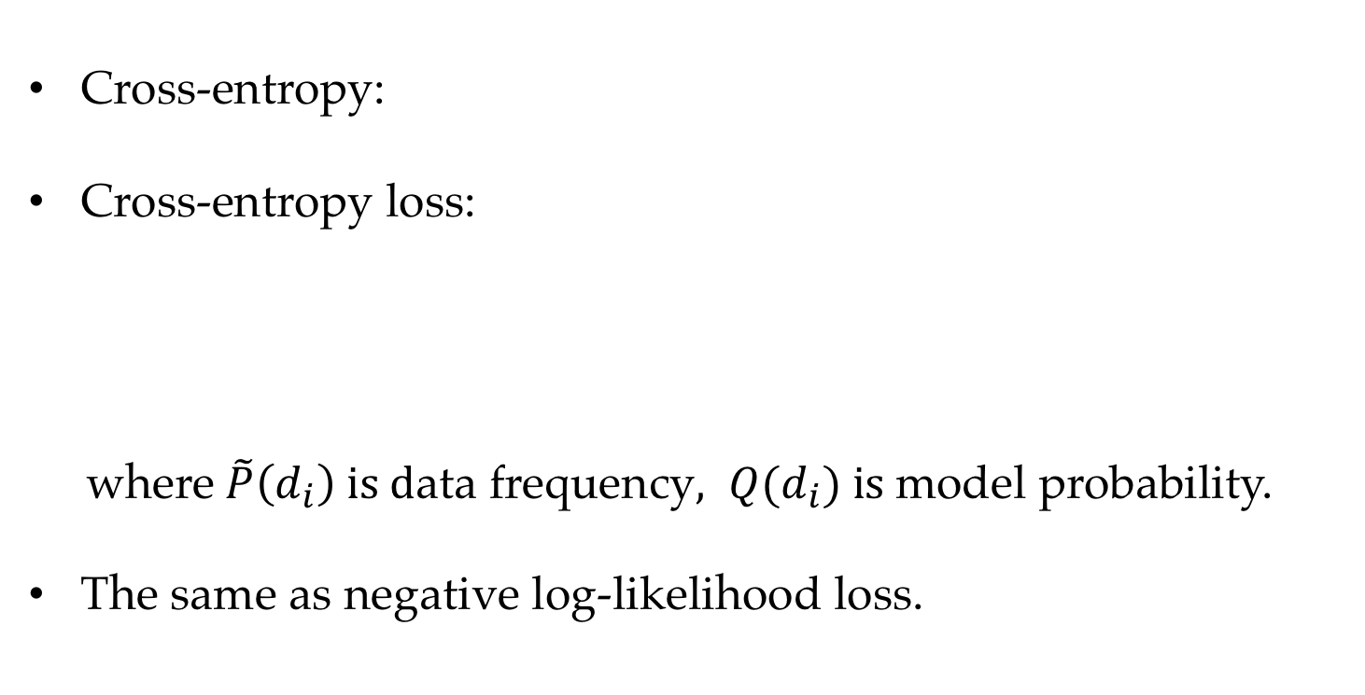
Cross entropy loss
Cross-entropy:
Cross-entropy loss:
where $\tilde{P}\left(d_{i}\right) is d$ata frequency$, Q(d_{i}) is$model probability.
The same as negative log-likelihood loss.

Slide 38
Contents
5.1 The maximum entropy principle
5.1.1 Information and entropy
5.1.2 A naïve maximum entropy model
5.1.3 Maximum entropy model and training data
5.2 KL-Divergence, Cross-Entropy and Model Perplexity
5.2.1 KL-divergence
5.2.2 Cross entropy
5.2.3 Model Perplexity
5.3 Mutual information
5.3.1 Pointwise mutual information
5.3.2 Using PMI

Slide 39
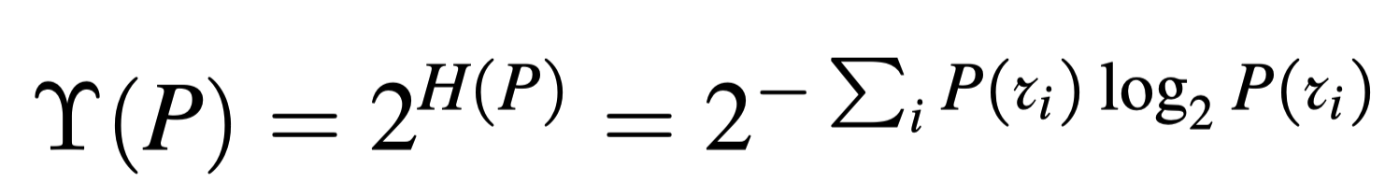
Perplexity
Formally
Intuitively, perplexity represents the expected number of bits necessary for encoding each outcome.

Slide 40
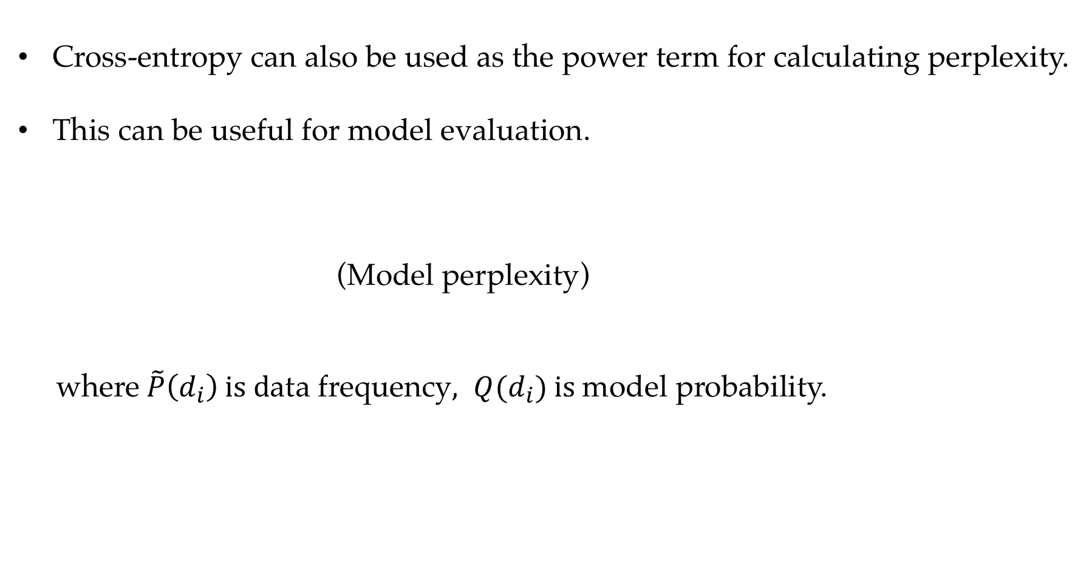
Model Perplexity
Cross-entropy can also be used as the power term for calculating perplexity.
This can be useful for model evaluation.
(Model perplexity)
where $\tilde{P}\left(d_{i}\right) is d$ata frequency$, Q(d_{i}) is$model probability.

Slide 41
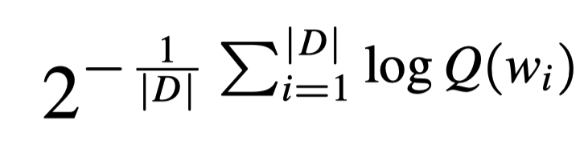
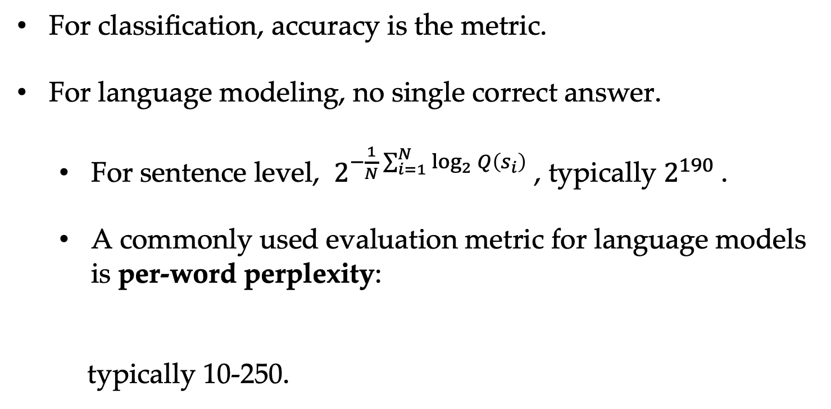
Evaluating language models
For classification, accuracy is the metric.
For language modeling, no single correct answer.
For sentence level, $2^{−\frac{1}{N}\sum_{i=1}^{N}{\log_{2}{Q\left(s_{i}\right)}}}$ , typically $2^{190}$.
A commonly used evaluation metric for language models is per-word perplexity:
typically 10-250.

Slide 42
Contents
5.1 The maximum entropy principle
5.1.1 Information and entropy
5.1.2 A naïve maximum entropy model
5.1.3 Maximum entropy model and training data
5.2 KL-Divergence, Cross-Entropy and Model Perplexity
5.2.1 KL-divergence
5.2.2 Cross entropy
5.2.3 Model Perplexity
5.3 Mutual information
5.3.1 Pointwise mutual information
5.3.2 Using PMI

Slide 43
Entropy, Cross-Entropy, Mutual Information
Entropy – the expected number of bits to encode a random variable.
The number of bits in average when encoding many outcome values. Optimal encoding scheme.
Cross-Entropy – the expected number of bits to encode a random variable using a different encoding scheme. Two distributions concerning the same random variable.
Evaluate model distribution against data distribution
Calibrate model distribution against data.
Mutual Information – the expected number of bits you can save for encoding a random variable if a second random variable is known.
About two random variables.

Slide 44
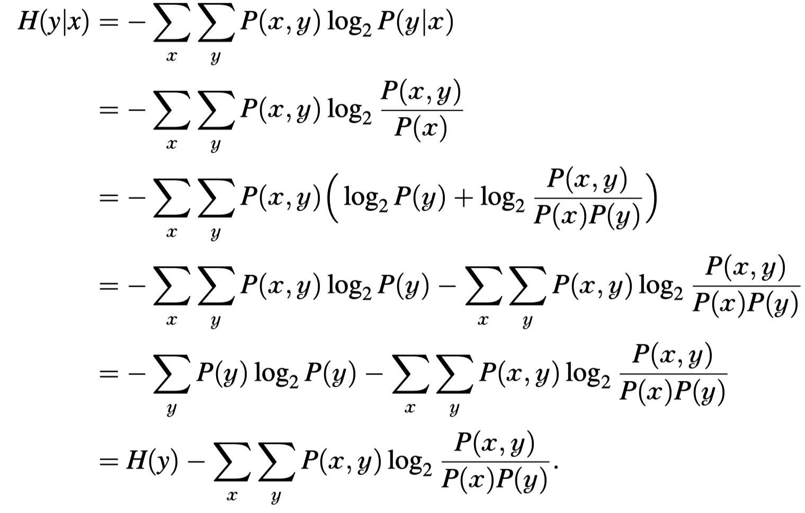
Mutual information

Slide 45
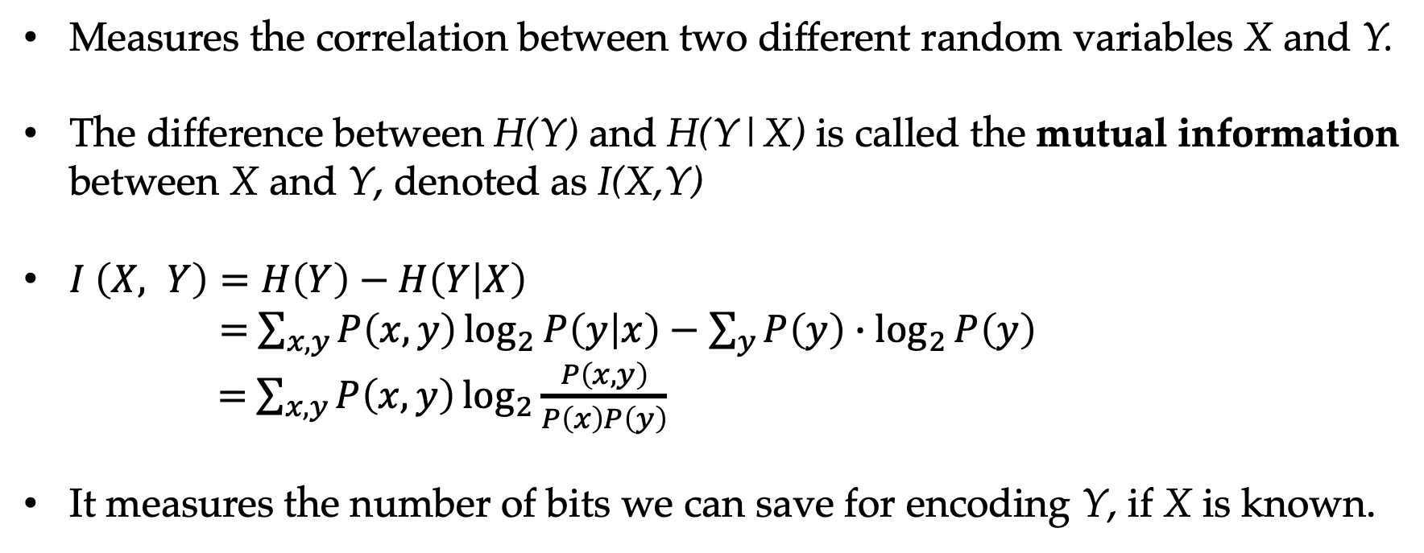
Mutual information
Measures the correlation between two different random variables X and Y.
The difference between H(Y) and H(Y|X) is called the mutual information between X and Y, denoted as I(X,Y)
$I \left(X, Y\right)=H\left(Y\right)−H\left(Y | X\right)$
$=$ $\sum_{x,y}{P\left(x, y\right)\log_{2}{P\left(y | x\right)−\sum_{y}{P\left(y\right)∙\log_{2}{P\left(y\right)}}}}$
$=$ $\sum_{x,y}{P\left(x,y\right)\log_{2}{\frac{P\left(x, y\right)}{P\left(x\right)P\left(y\right)}}}$
It measures the number of bits we can save for encoding Y, if X is known.

Slide 46
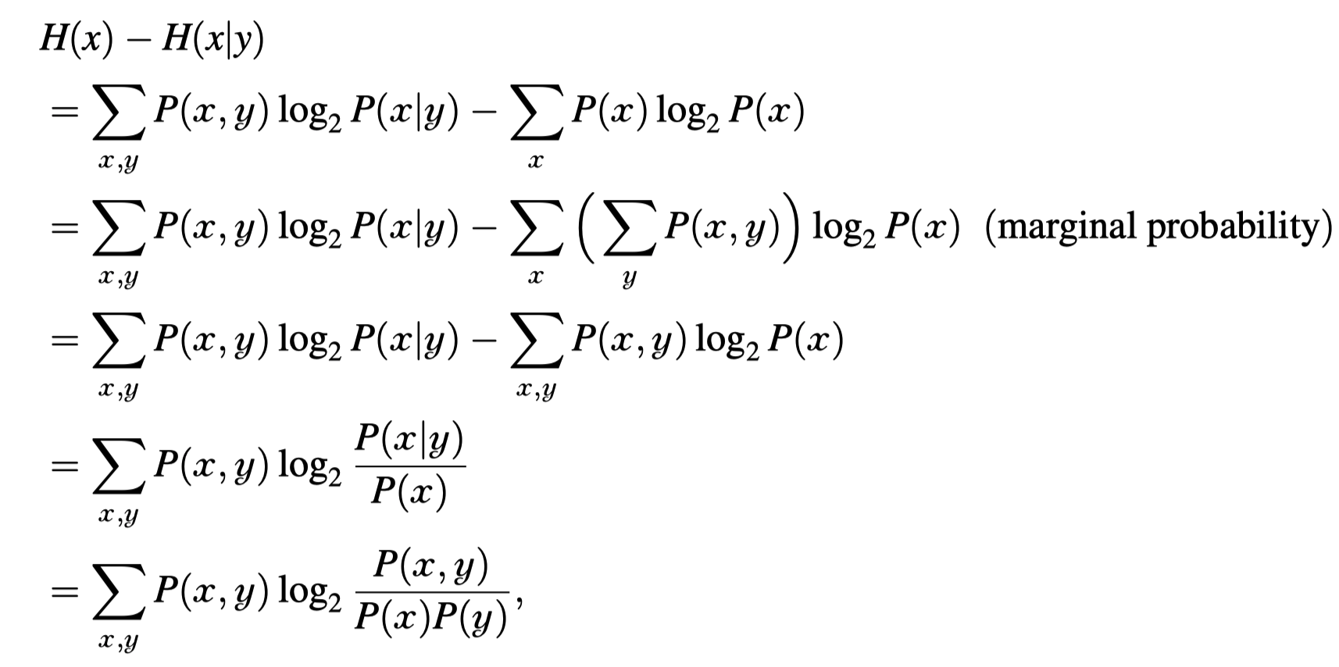
Mutual information
Mutual information is symmetric between X and Y, H(X)-H(X|Y) is equal to H(Y)-H(Y|X).

Slide 47
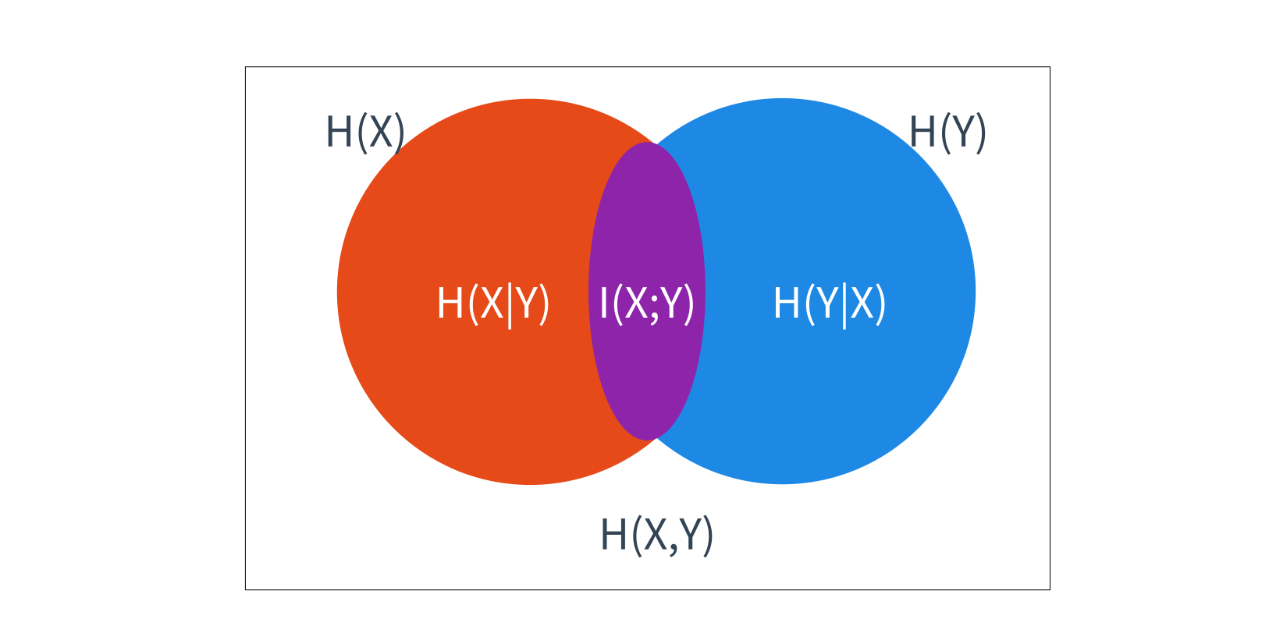
Conditional entropy

Slide 48
Contents
5.1 The maximum entropy principle
5.1.1 Information and entropy
5.1.2 A naïve maximum entropy model
5.1.3 Maximum entropy model and training data
5.2 KL-Divergence, Cross-Entropy and Model Perplexity
5.2.1 KL-divergence
5.2.2 Cross entropy
5.2.3 Model Perplexity
5.3 Mutual information
5.3.1 Pointwise mutual information
5.3.2 Using PMI

Slide 49
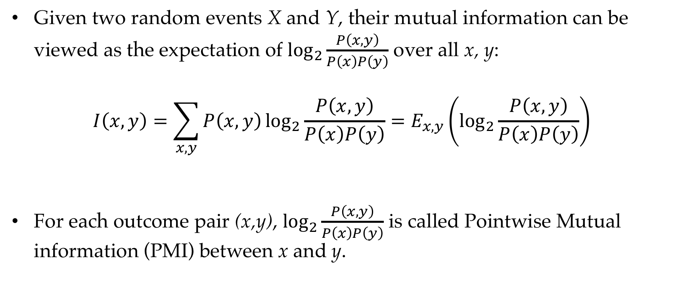
Pointwise mutual information
Given two random events X and Y, their mutual information can be viewed as the expectation of $\log_{2}{\frac{P\left(x,y\right)}{P\left(x\right)P\left(y\right)}}$ over all x, y:
$$I\left(x,y\right)=\sum_{x,y}{P\left(x,y\right)\log_{2}{\frac{P\left(x,y\right)}{P\left(x\right)P\left(y\right)}}}=E_{x,y}\left(\log_{2}{\frac{P\left(x,y\right)}{P\left(x\right)P\left(y\right)}}\right)$$
For each outcome pair (x,y), $\log_{2}{\frac{P\left(x,y\right)}{P\left(x\right)P\left(y\right)}}$ is called Pointwise Mutual information (PMI) between x and y.

Slide 50
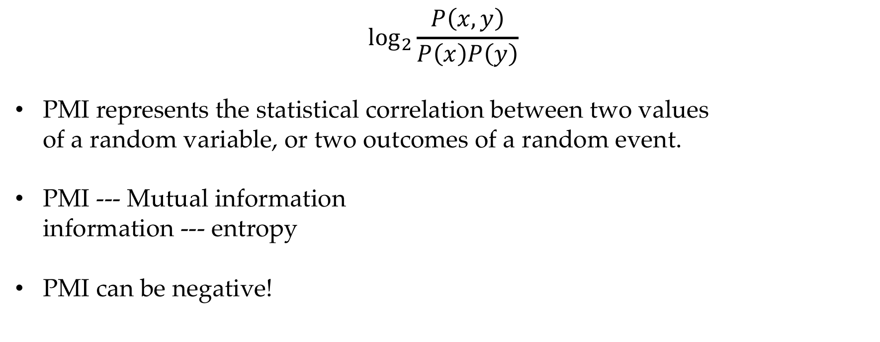
Pointwise mutual information
$$\log_{2}{\frac{P\left(x,y\right)}{P\left(x\right)P\left(y\right)}}$$
PMI represents the statistical correlation between two values of a random variable, or two outcomes of a random event.
PMI --- Mutual information information --- entropy
PMI can be negative!

Slide 51
Contents
5.1 The maximum entropy principle
5.1.1 Information and entropy
5.1.2 A naïve maximum entropy model
5.1.3 Maximum entropy model and training data
5.2 KL-Divergence, Cross-Entropy and Model Perplexity
5.2.1 KL-divergence
5.2.2 Cross entropy
5.2.3 Model Perplexity
5.3 Mutual information
5.3.1 Pointwise mutual information
5.3.2 Using PMI

Slide 52
Using PMI to mine knowledge from texts
The correlation between variables.
Words and sentiment signals.
Neighboring words.
Features and class labels.

Slide 53
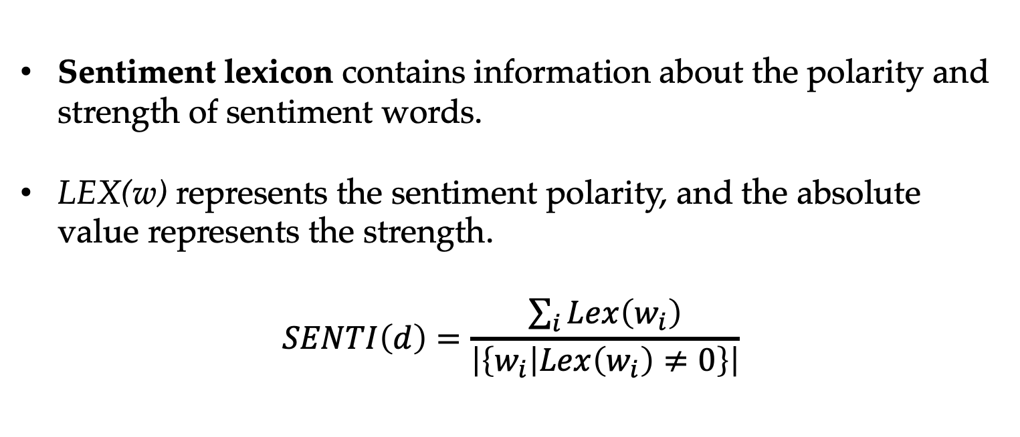
Learning sentiment lexicons
Sentiment lexicon contains information about the polarity and strength of sentiment words.
LEX(w) represents the sentiment polarity, and the absolute value represents the strength.
$$SENTI\left(d\right)=\frac{\sum_{i}{Lex\left(w_{i}\right)}}{\left|\left\{w_{i} | Lex\left(w_{i}\right)≠0\right\}\right|}$$

Slide 54

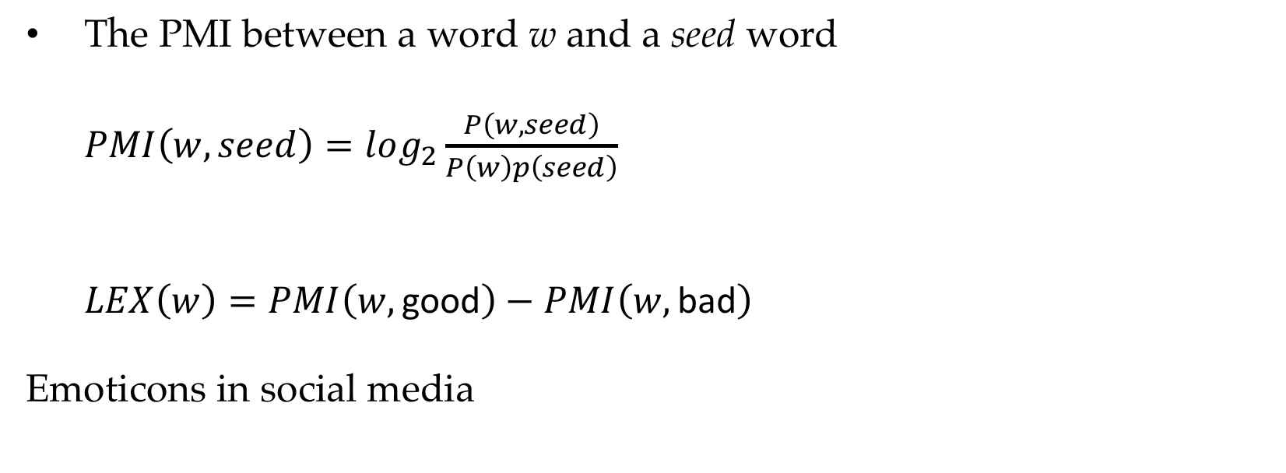
Learning sentiment lexicons
The PMI between a word w and a seed word
$PMI\left(w,seed\right)=log_{2}\frac{P\left(w,seed\right)}{P\left(w\right)p\left(seed\right)}$
$LEX\left(w\right)=PMI\left(w,\text{good}\right)−PMI\left(w,\text{bad}\right)$
Emoticons in social media

Slide 55

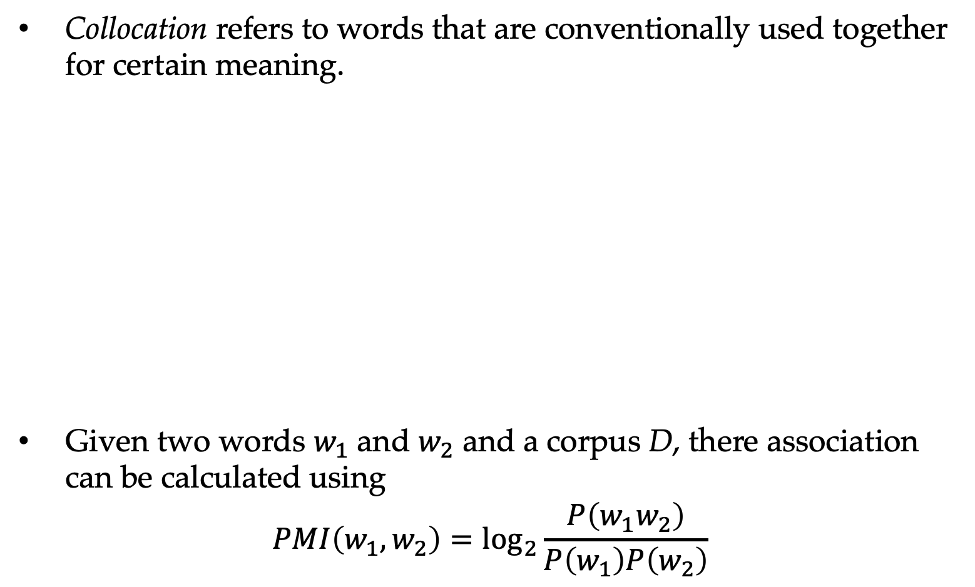
Collocation extraction
Collocation refers to words that are conventionally used together for certain meaning.
Given two words $w_{1}$ and $w_{2}$ and a corpus D, there association can be calculated using
$$PMI\left(w_{1},w_{2}\right)=\log_{2}{\frac{P\left(w_{1}w_{2}\right)}{P\left(w_{1}\right)P\left(w_{2}\right)}}$$

Slide 56
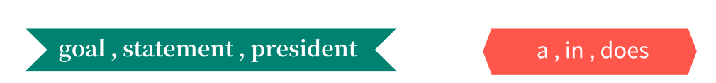
Using PMI to select features
Feature selection: reduce the size of the feature vector
important features unimportant features
PMI between feature and class is a commonly used metric for feature selection, the higher PMI value, the more likely w is a strong indicator of c.

Slide 57
PMI and vector representations of words
Representing a word in vector space
Useful for measuring semantic correlations
Thus far we have only learned a ``one-hot’’ representation

Slide 58
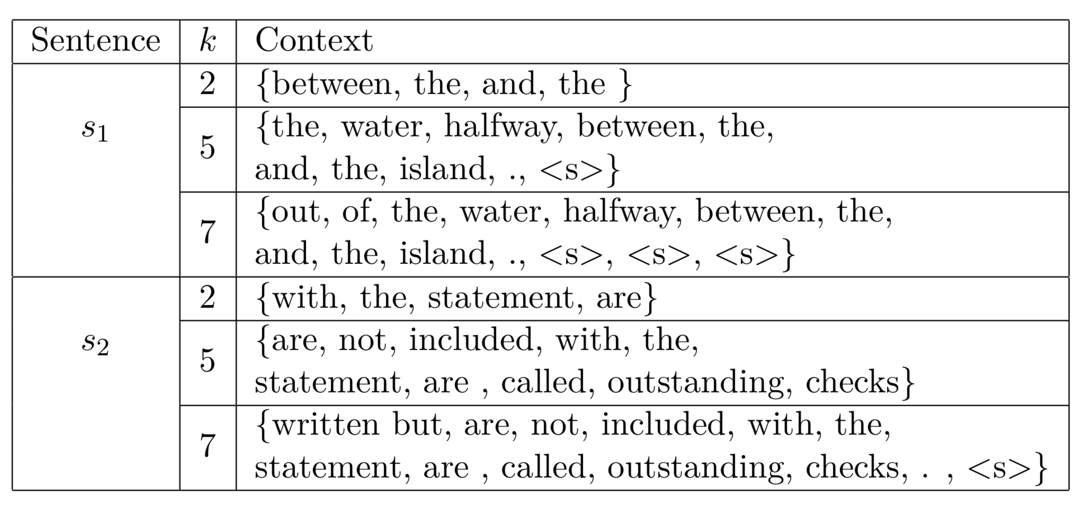
PMI and vector representations of words
Distributional semantics : the company of a word (k-word windows) tells us much information about its attributes.
K-word windows for the word "bank” in s1 --- There happened to be a rock sticking out of the water halfway between the bank and the island s2 --- The checks that have been written but are not included with the bank statement are called outstanding checks

Slide 59
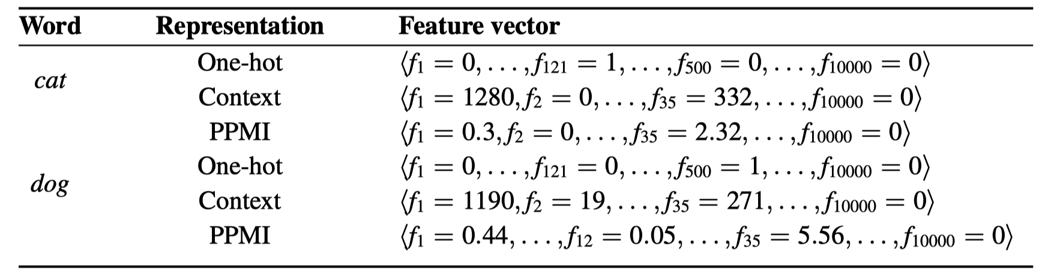
Word Representation
cat --- 121, dog --- 500, considering vector dot product.

Slide 60
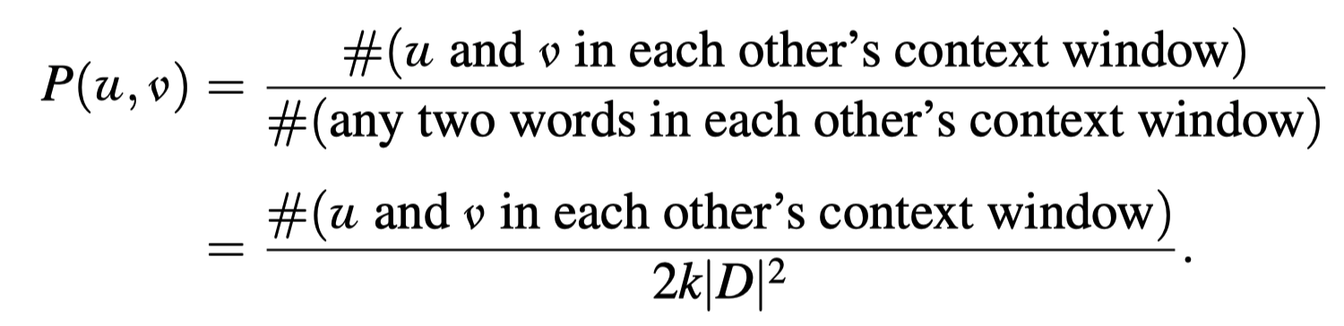

PMI and vector representations of words
The vector representation of a word $w_{i}$ is :
$$\overline{Vec\left(w_{i}\right)}=\left\langle PMI\left(w,w_{1}\right),PMI\left(w,w_{2}\right),…,PMI\left(w,w_{\left|V\right|}\right)\right\rangle$$

Slide 61
Word Representation
PMI and TF-IDF.

Slide 62

PMI and vector representations of words
$PPMI\left(u,v\right)=max⁡(PMI\left(u,v \right),0)$
We use positive PMI (PPMI) to reduce noise and the non-informative.
Using PPMI, non differentiating words will have a small contribution to the distributional word representation.

Slide 63
Summary
Entropy and information.
The maximum entropy principle for defining probabilistic models, and its application in deriving log-linear model forms
Model perplexity, cross-entropy and KL-divergence for measuring the consistence between model distributions and data distributions
Mutual information and pointwise mutual information (PMI) for natural language tasks
Word representations and pointwise mutual information.

